Slide 1

WAY TO ENTERPRISE
Java Basics
VTI ACADEMY
Author: duy.nguyenngoc1@vti.com.vn
March 2020

Slide 2
Agenda
3-layers Architecture
Comment template
Assignments
Copyright © VTI Academy All Rights Reserved

Slide 3
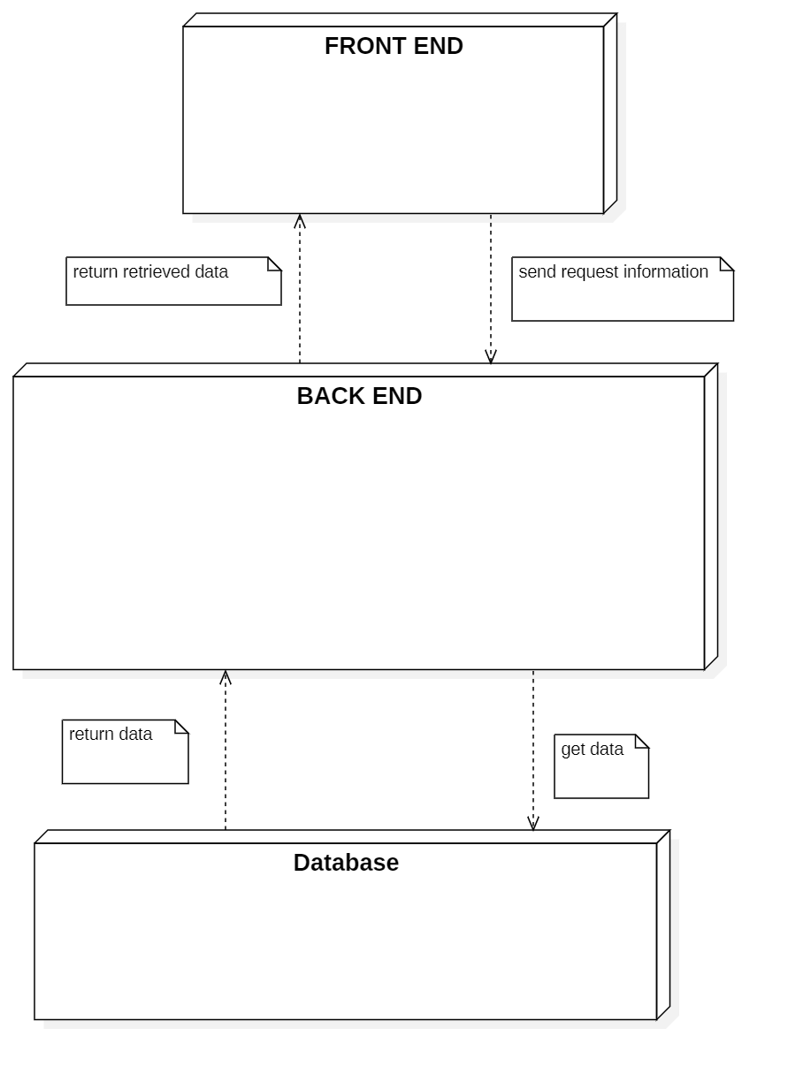
3-tiers Architecture

Slide 4
3-layers Architecture
Basic
Validation & Handling Exception
Handling business Logic

Slide 5
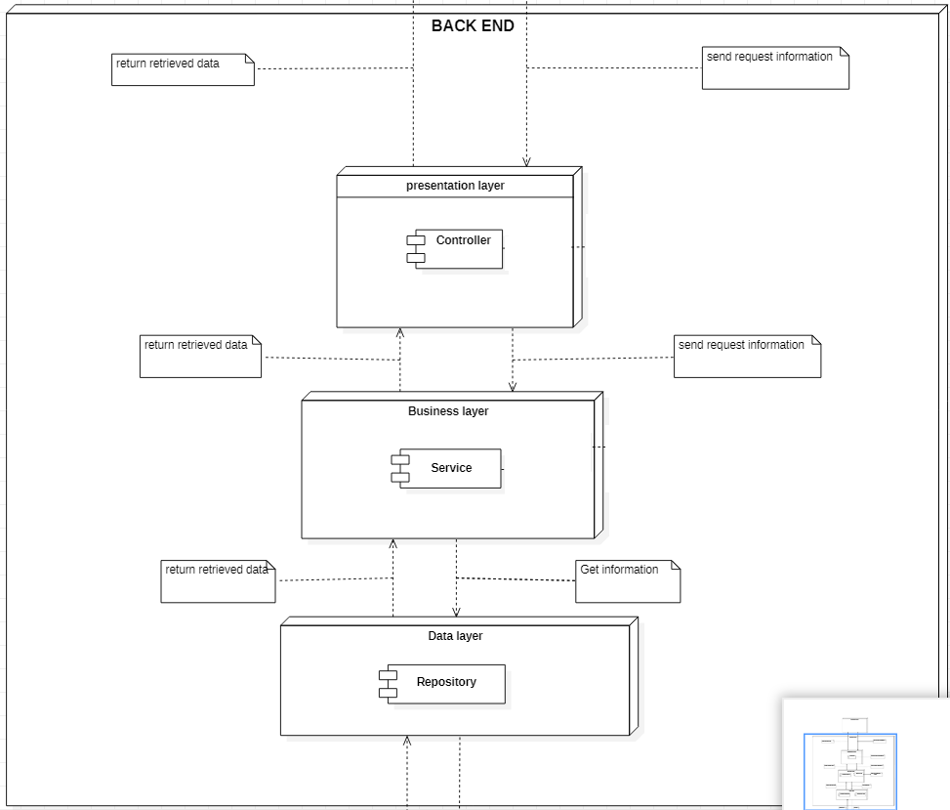
Basic

Slide 6
Testing System Assignments
Exercise 1: Basic

Slide 7
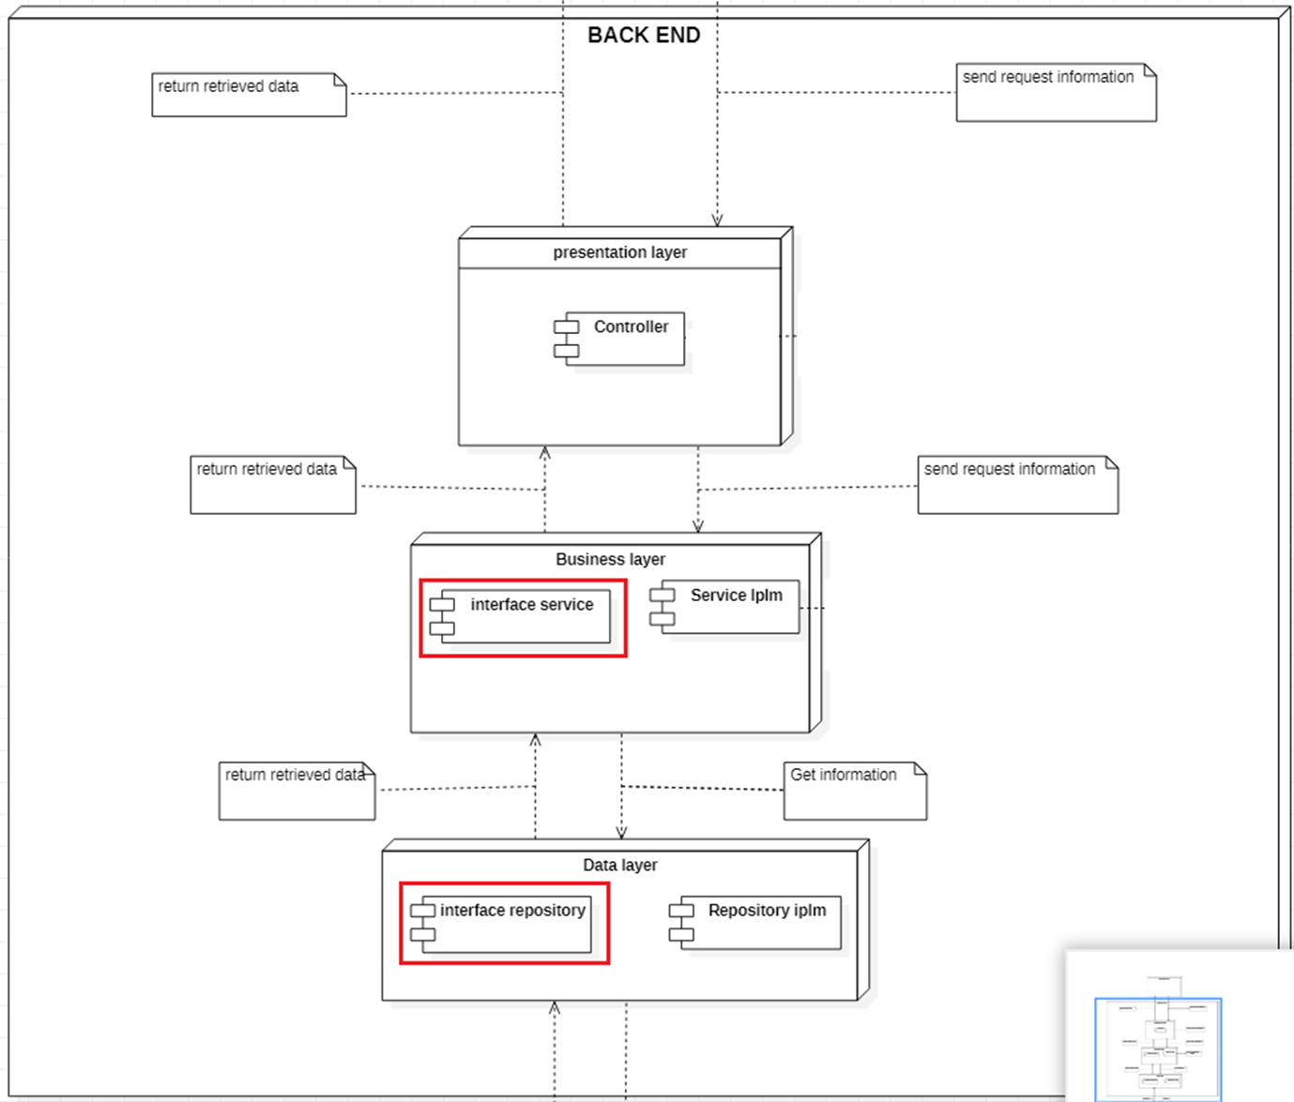
Basic (interface)

Slide 8
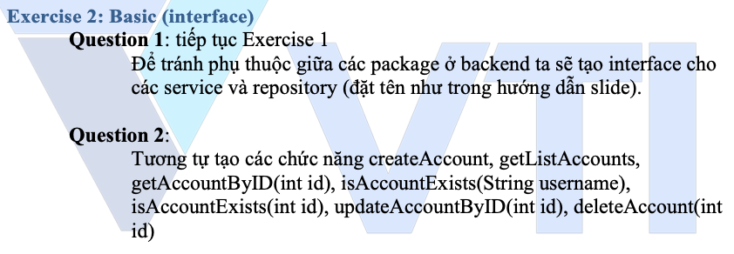
Testing System Assignments
Exercise 2: Basic (interface)

Slide 9
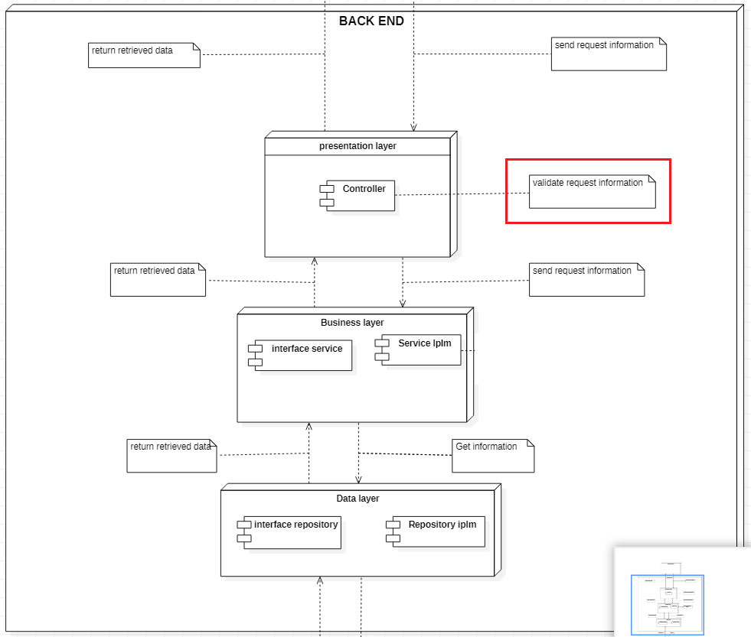
Validation & Handling Exception

Slide 10
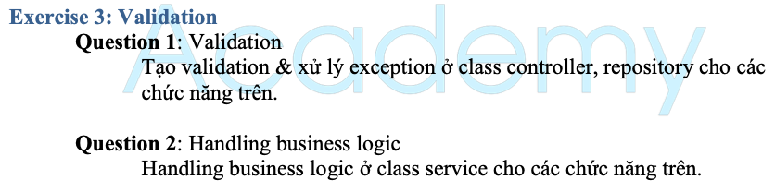
Testing System Assignments
Exercise 3: Validation

Slide 11
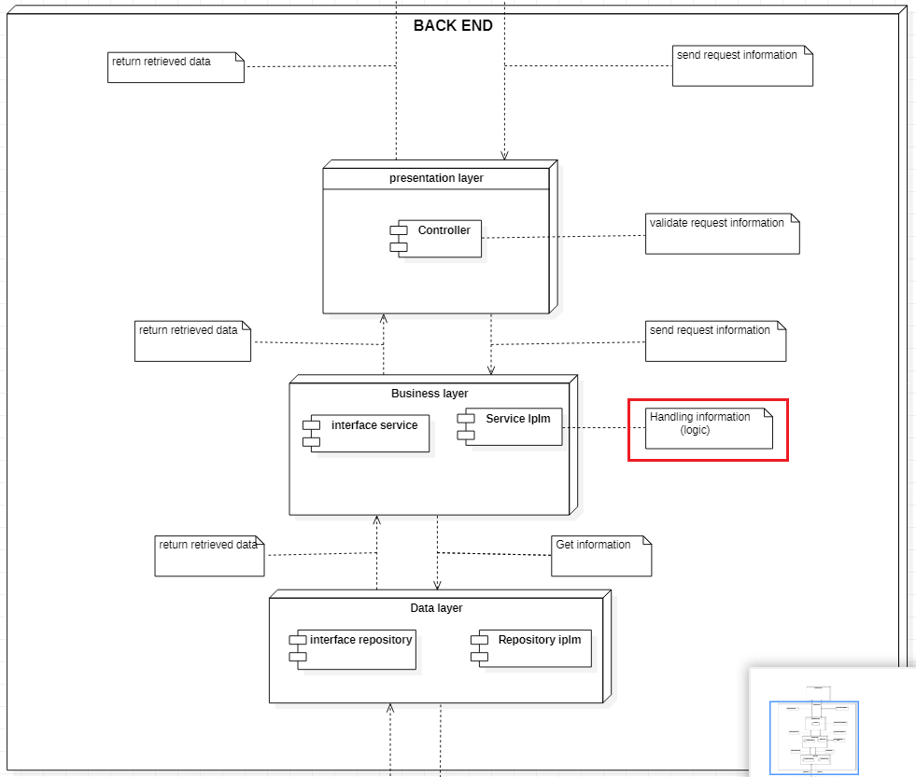
Handling business Logic

Slide 12
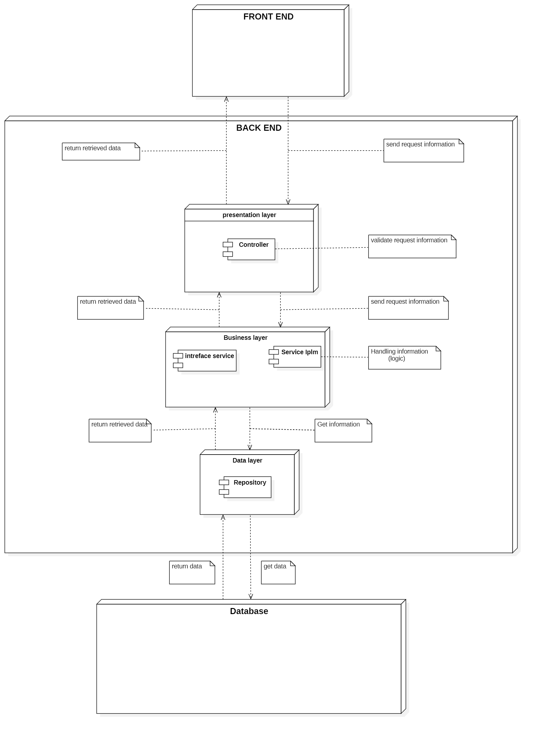
3-tiers Architecture

Slide 13
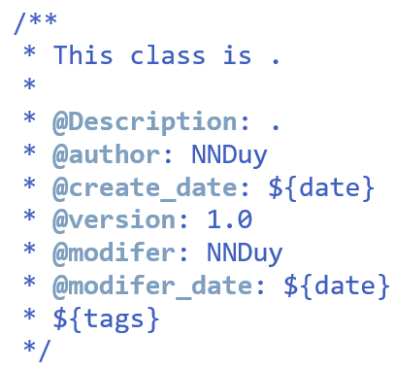
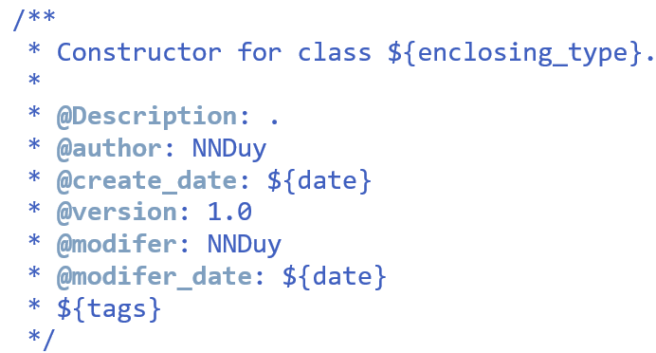
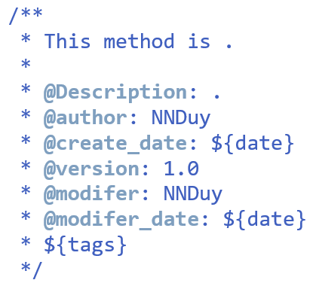
Comment template
Window → Preferences → Java → code Style → Code Templates
Shortcut: Alt + shift + j

Slide 14
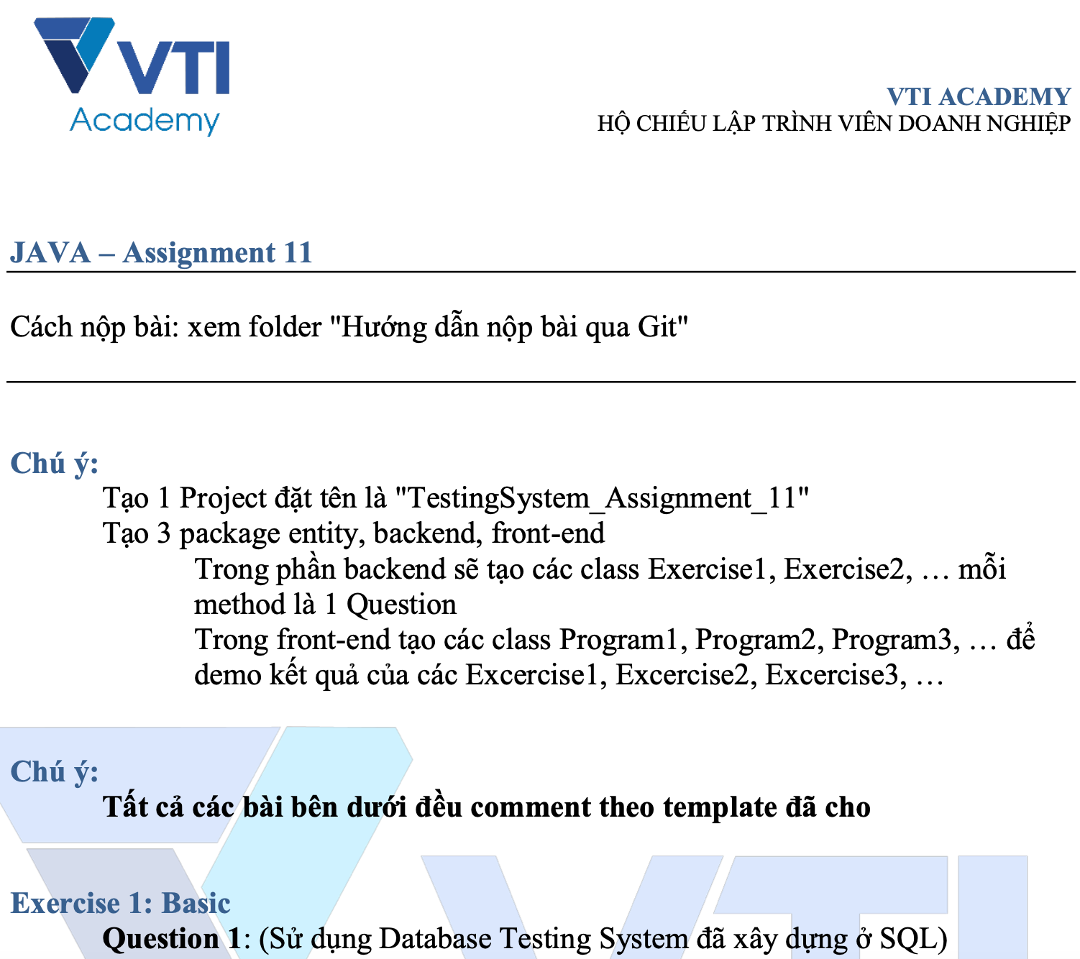
Testing System Assignments

Slide 15
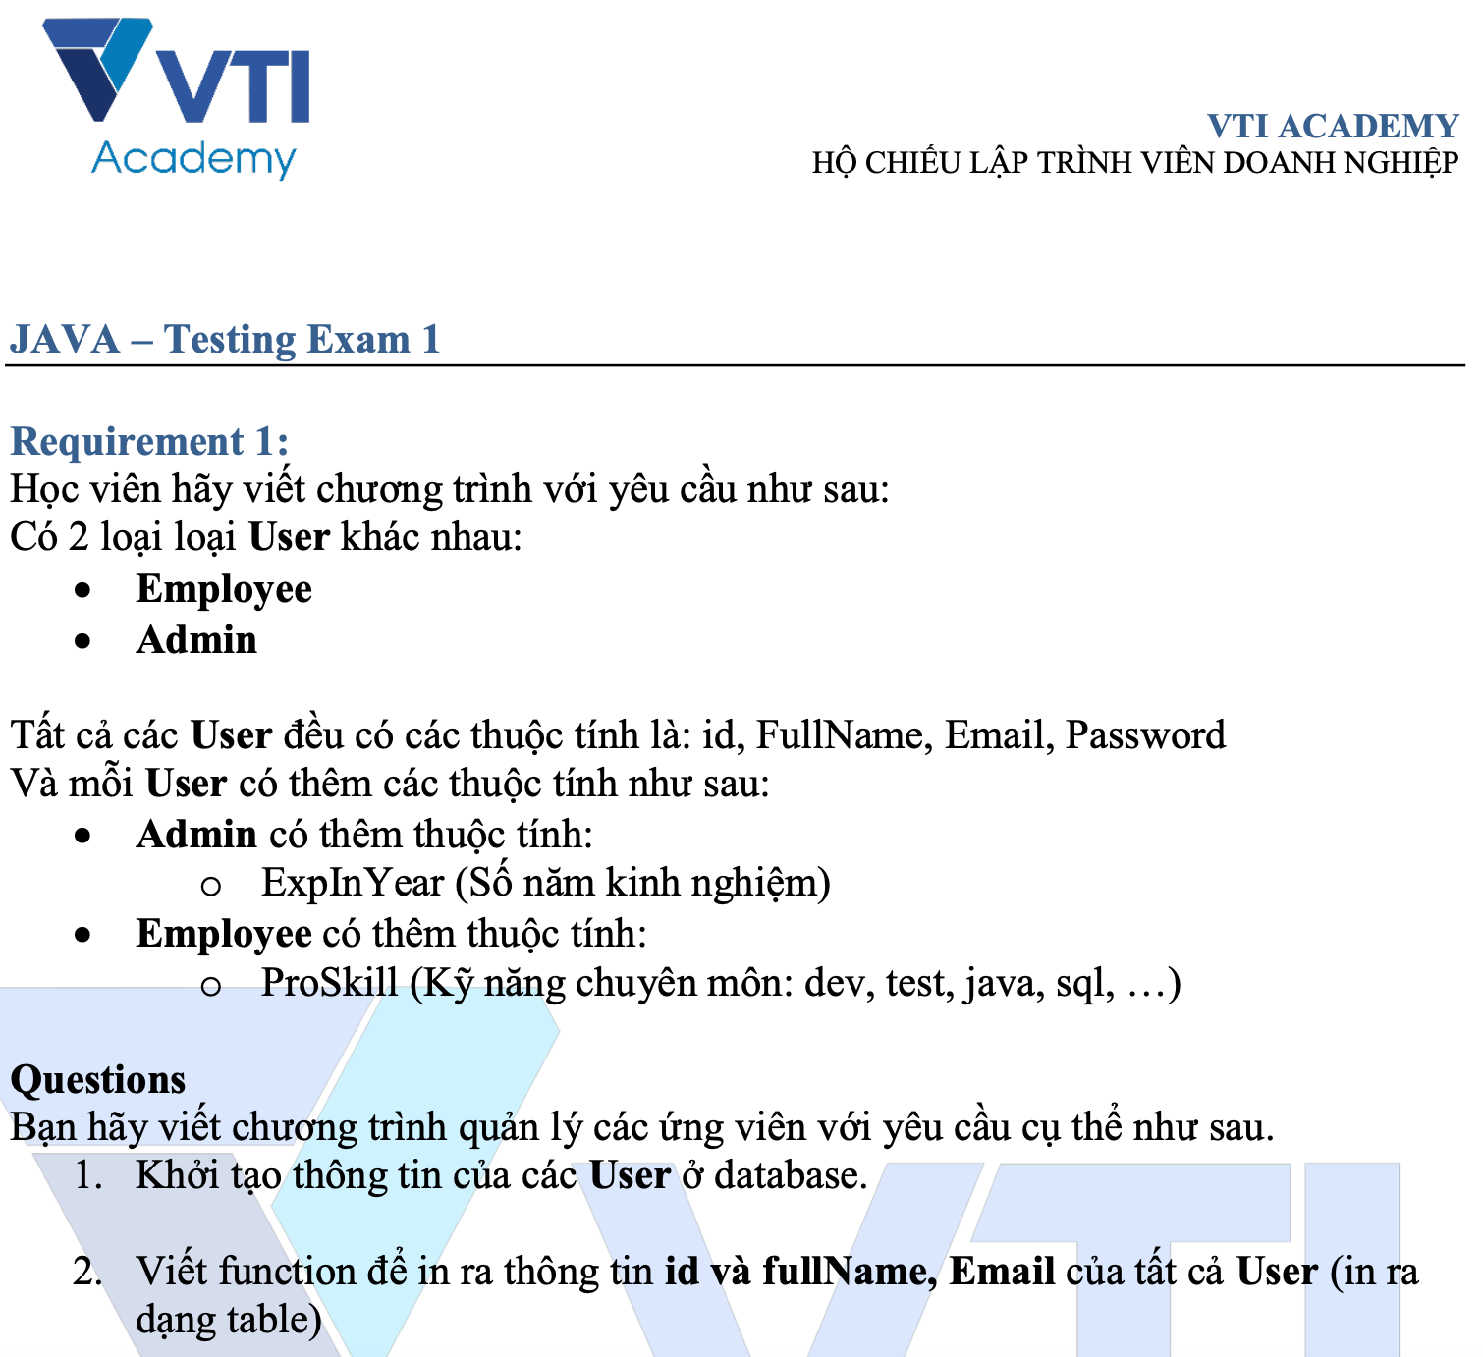
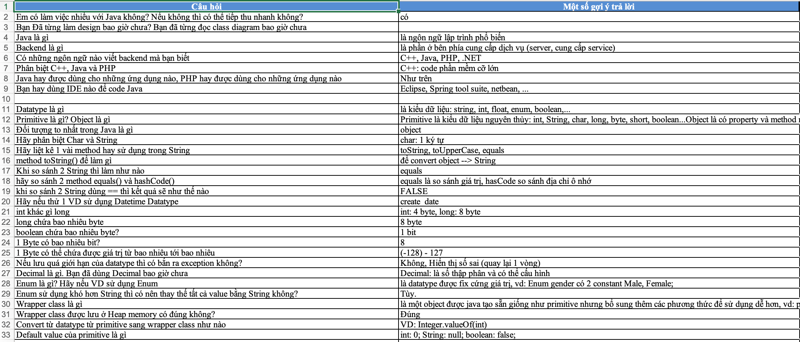
Testing Exam
https://docs.google.com/spreadsheets/d/1KdhxJmJGWlec3r81gBvN862uDzvak0d4?rtpof=true

Slide 16
Q & A
Copyright © VTI Academy All Rights Reserved

